Slide 1
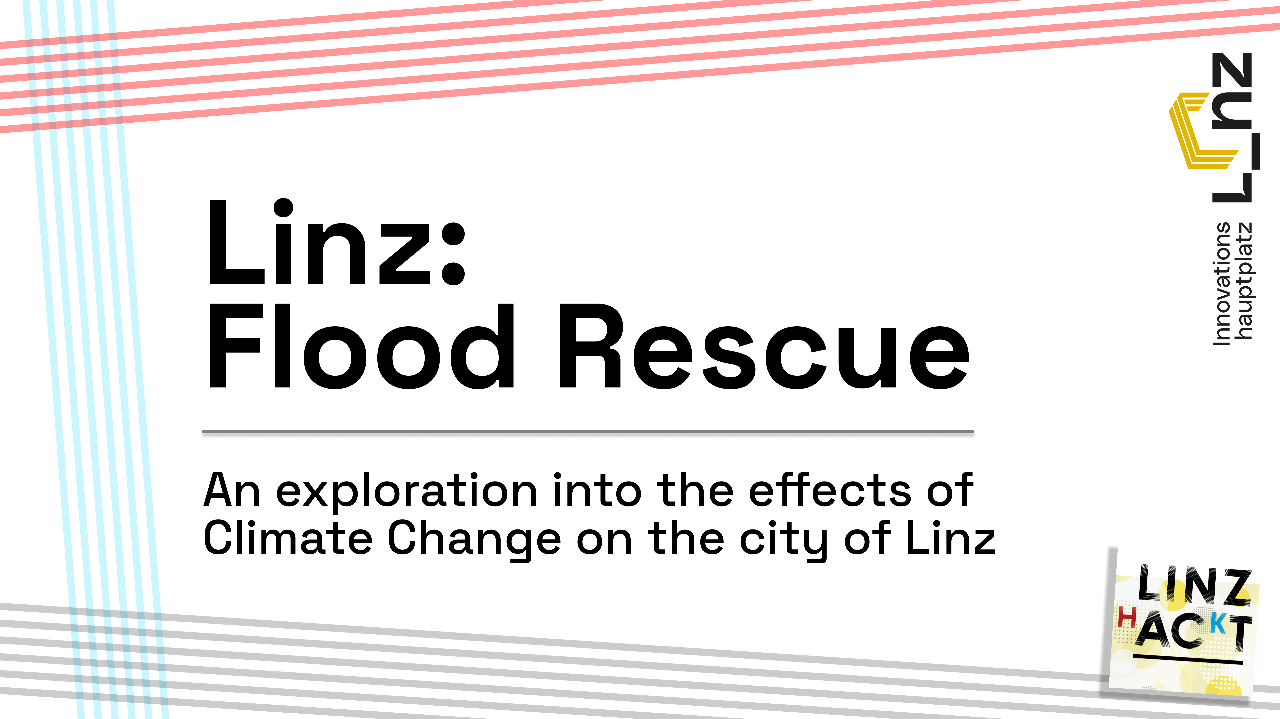

Slide 2
Climate change: an everyday topic
We are constantly being bombarded with the topic of climate change, and yet almost no one is changing their ways.
Most of the talk about climate change is “in theory”, we aren’t being shown the effects first-hand.
Climate change isn’t a big problem for big cities only, it’s a problem for Linz as well.

Slide 3
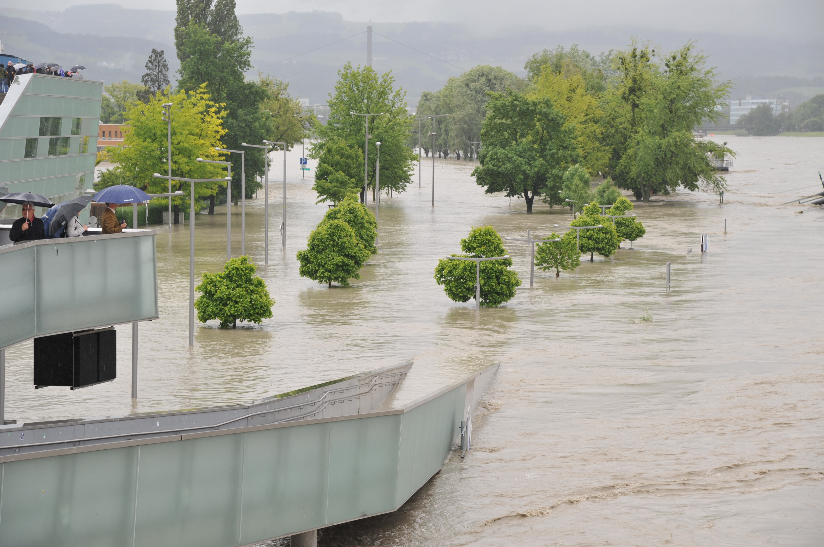
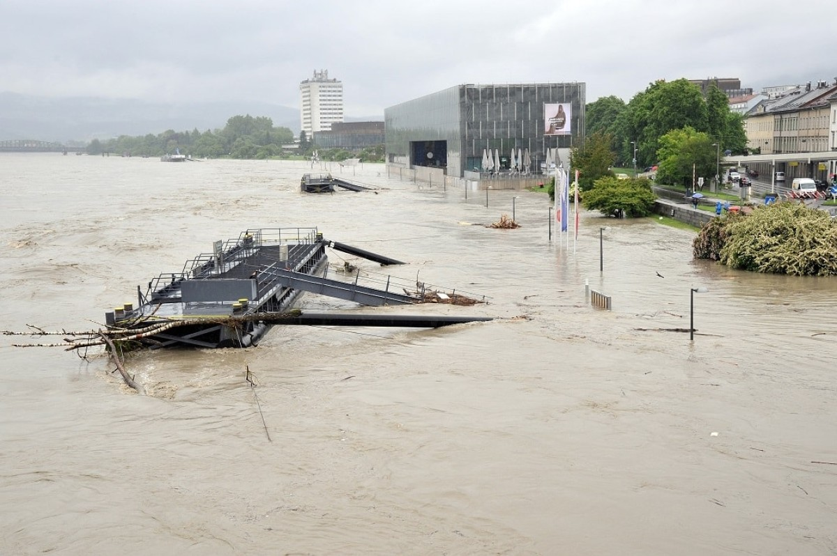
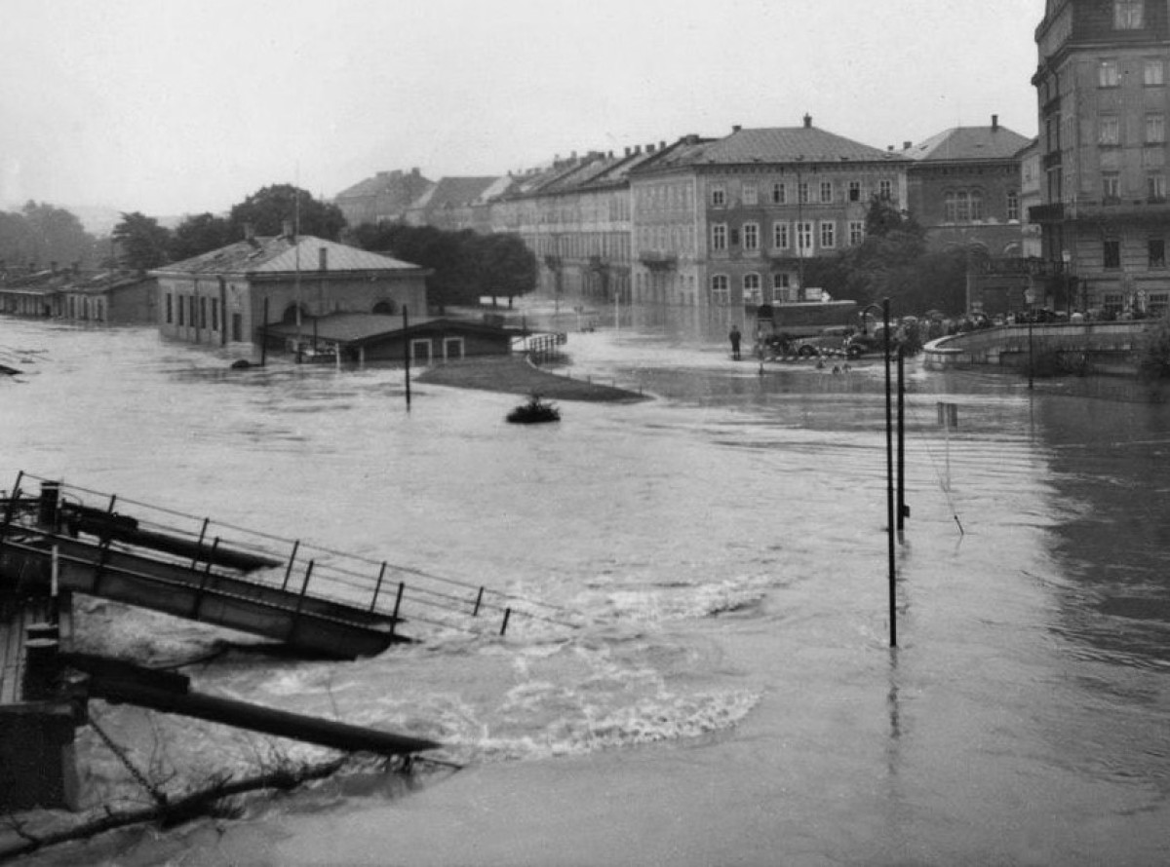
Linz in the past
Linz has suffered natural disasters in the past
The frequency and intensity of these are only going to get worse as time goes on

Slide 4
Flooding’s impact on the world
Historically, big cities have almost always been built near bodies of water
There are many reasons for this:
  Ease of transportation
  Reliable water supply
  Climate regulation options
However, that’s a double edged sword.
  water pollution
  erosion
  most importantly in our case, flooding.

Slide 5
Our project for this Hackathon
We want to raise awareness by not only telling people impersonal facts, but by actually showing them a possible reality.

Slide 6
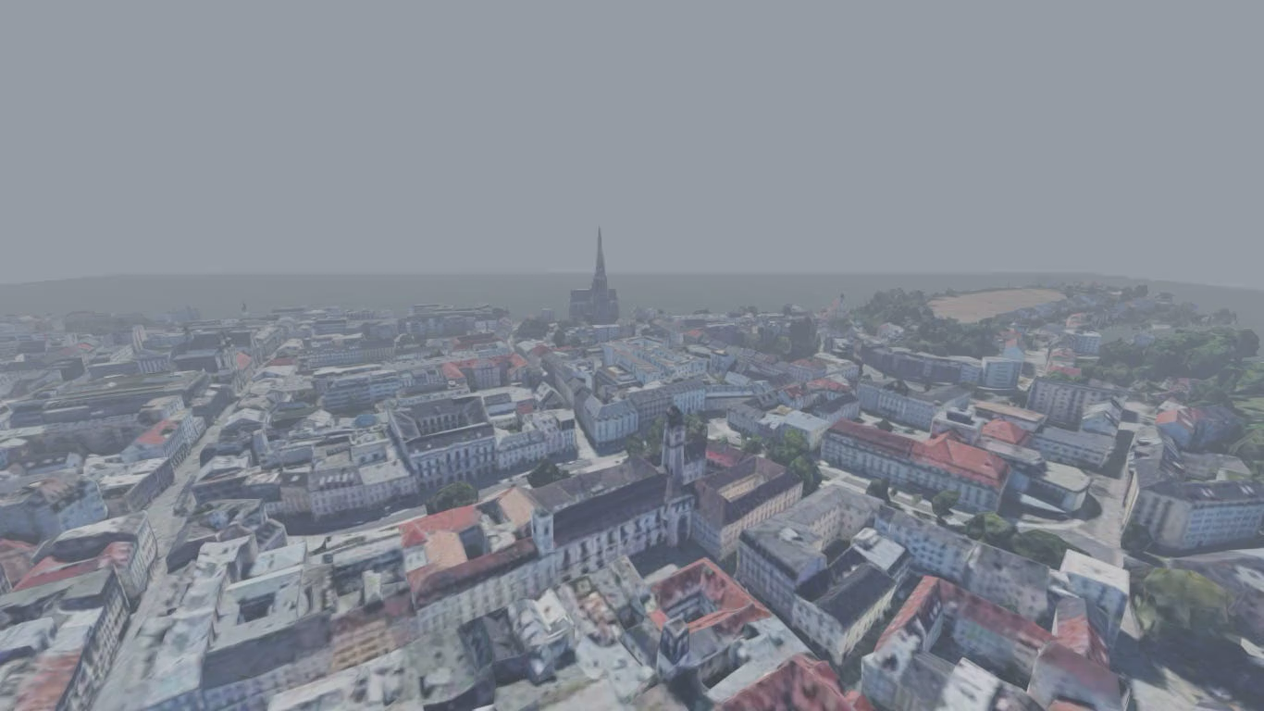
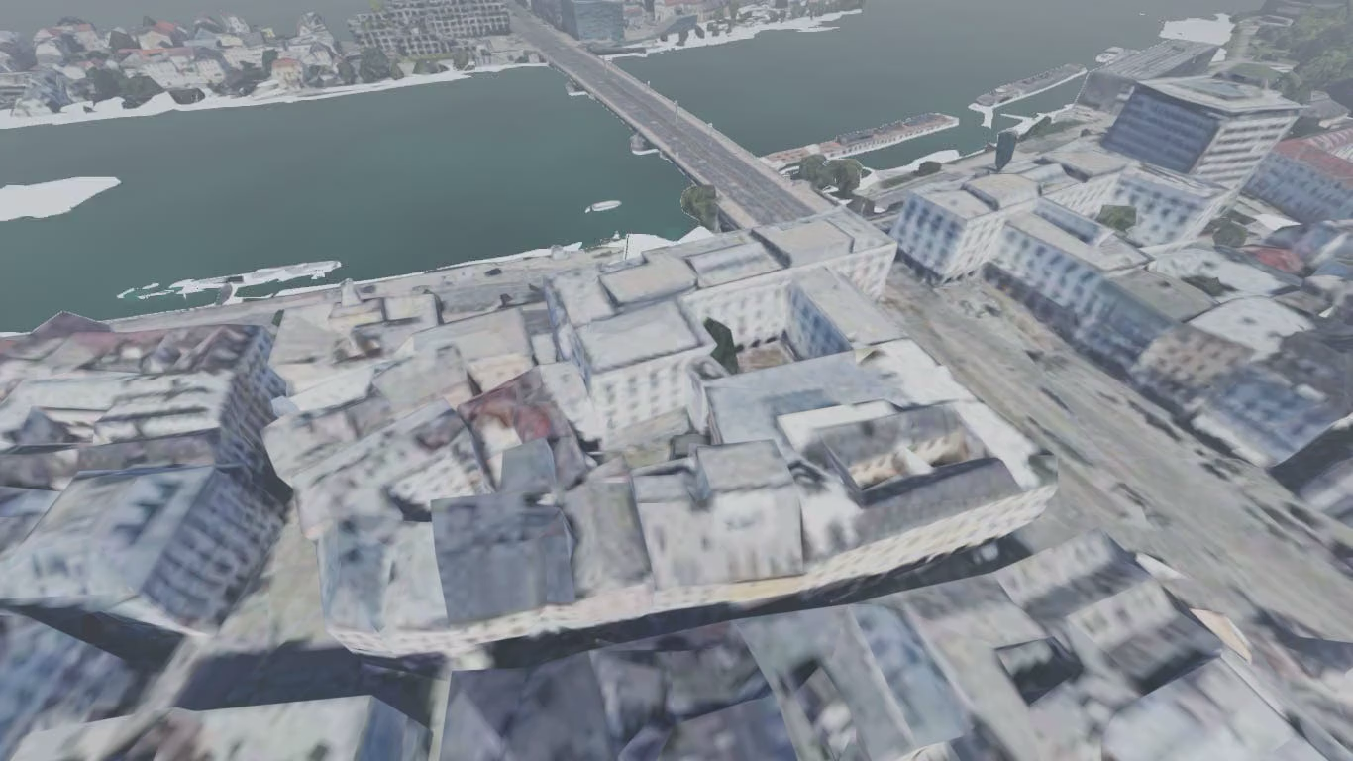
Meet “Linz: Flood Rescue”

Slide 7
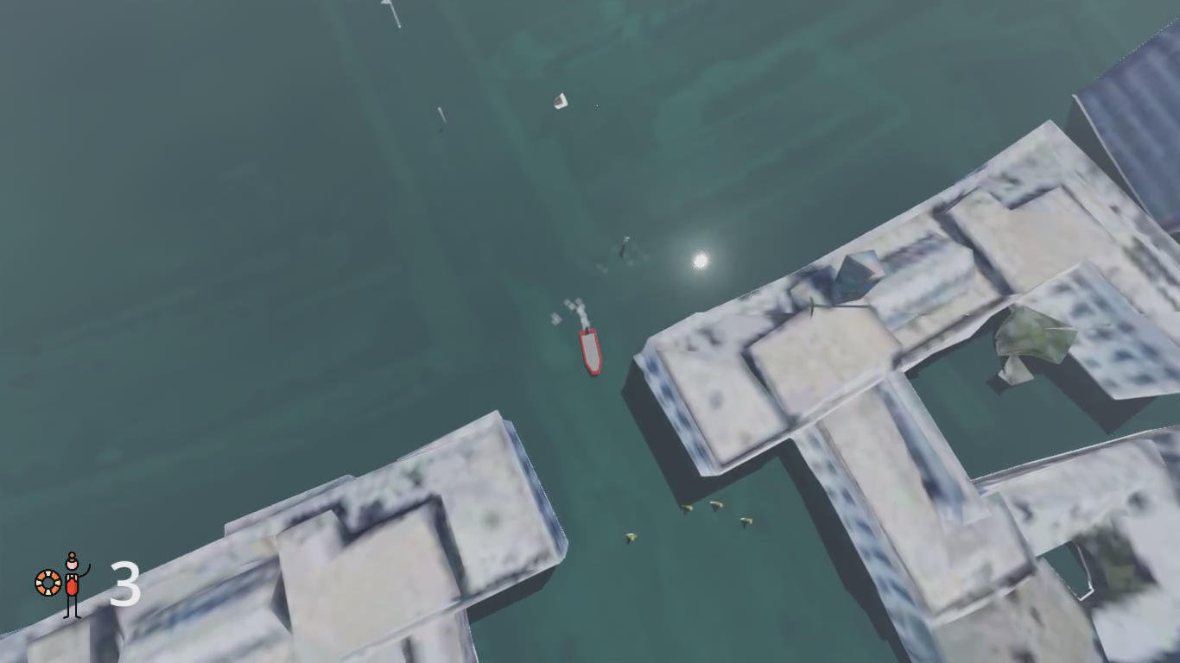

Slide 8
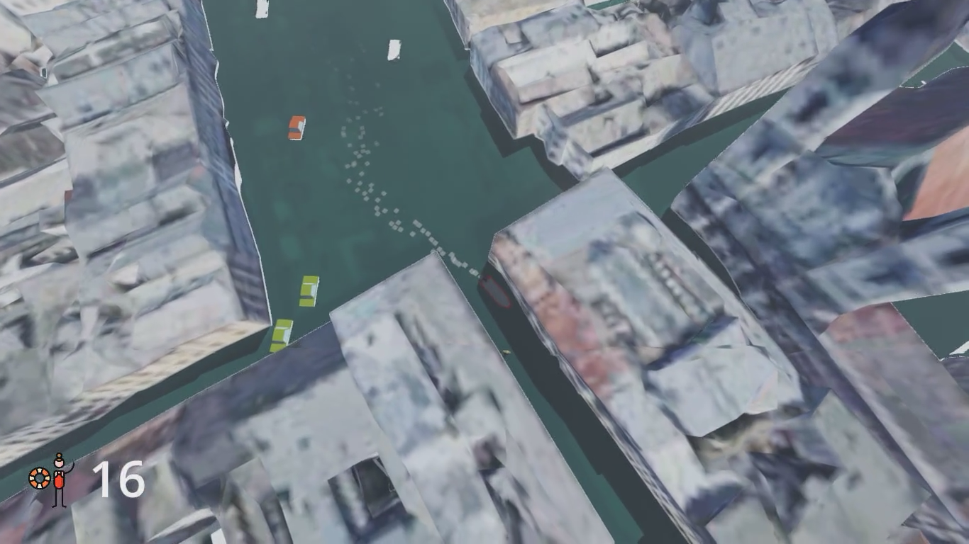

Slide 9
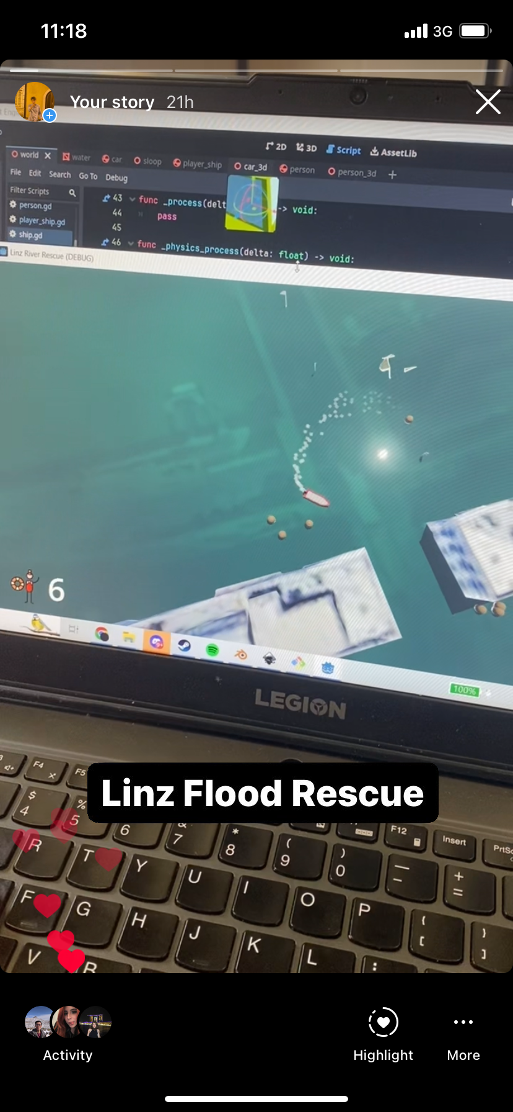
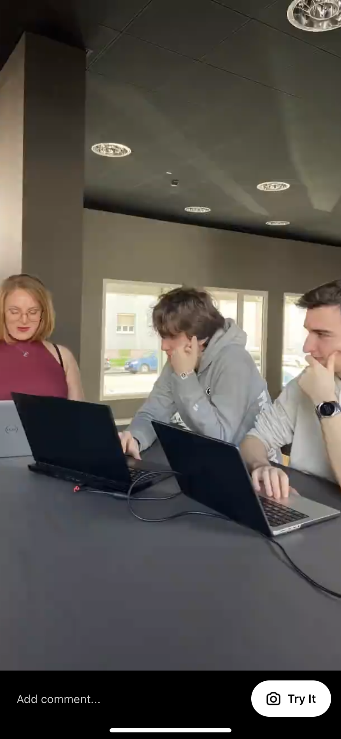
Sharing our idea
We have talked to mentors, friends, and family
We also shared the idea on social media to gauge interest

Slide 10
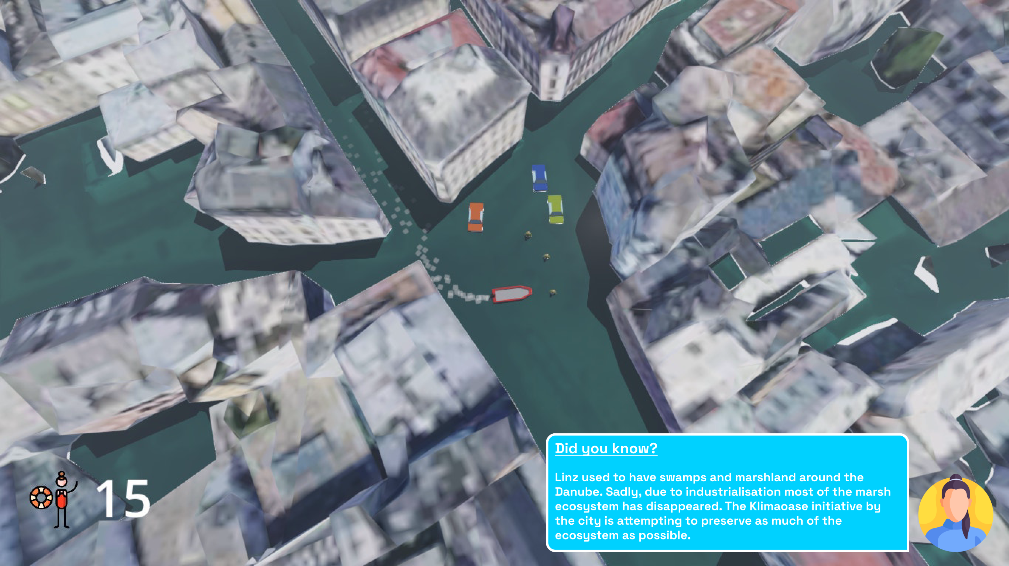
The grander concept

Slide 11
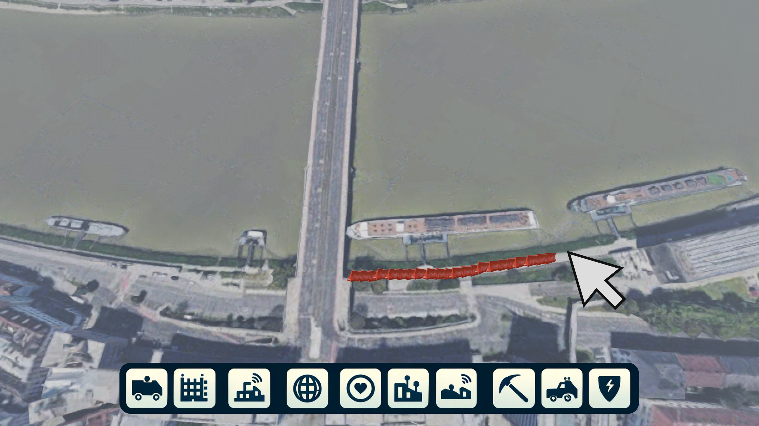
The grander concept - continued

Slide 12
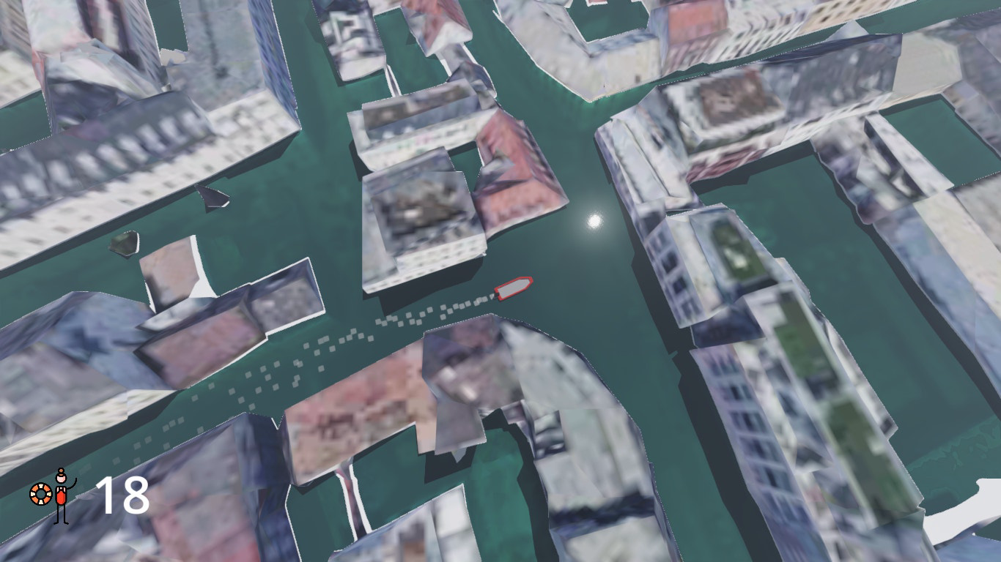
What did we learn?
People were either
  Shocked
  Surprised
  “wow”-ed
  Or all three.
We realised that people in our vicinity never thought of flooding like this, even though it has happened and most likely will happen in the future,

Slide 13
Our main concept and goal with our game
We want to make climate change personal and relatable
  Potentially by showing their homes or workplaces flooded
If we want to make a change, we all have to do our part.
This game, while being fun to play, is a frightening glimpse into a possible future, to show the reality of what could happen.
Notes:
Mention seeing your house or landmarks flooded

Slide 14
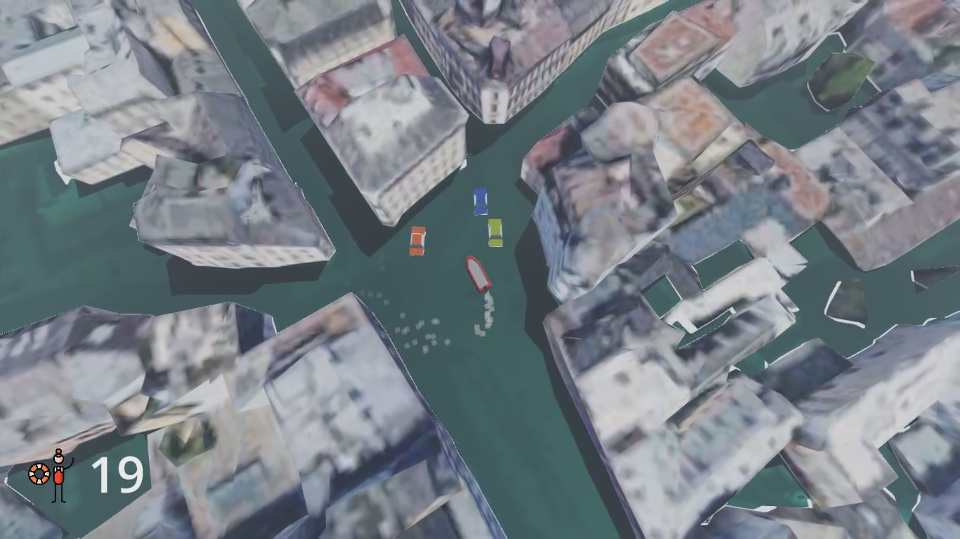
Our main message:
We need to take climate change personally, so that this does not become a reality!
Notes:
Next slide should be taking the idea further:
- city builder long term prep
Getting bite sized information from the people you rescue
Passing by pois and getting more info
Wildfire, controlling helicopter saving the nearby forests in linz

Slide 15
Special thanks to..
Additional sources used
The Organizers and Mentors of Linz Hackt
Innovations Hauptplatz
https://www.flaticon.com/free-icons/person
https://sketchfab.com/3d-models/low-poly-male-character-mesh-033082cf75bb48c98b15b28abc288ec5

